Slide 1
Secure Data Hiding in Image Using Steganography
CAPSTONE PROJECT
Presented By : Racharla Raghu Varma Venkata Sai
College Name & Department : KHIT ECE

Slide 2
OUTLINE
Problem Statement
Technology used
Wow factor
End users
Result
Conclusion
Git-hub Link

Slide 3
Problem Statement
In the digital age, data privacy and security are of utmost importance. With the increasing need to transfer sensitive information over the internet, there is a growing concern about the safety of the transmitted data. One of the challenges is to find a secure and inconspicuous way to embed sensitive information within seemingly innocuous files, such as images.
Steganography, the art of hiding data within other files, has emerged as an effective solution for embedding secret messages or data in a manner that is not easily detectable by unauthorized parties. However, simply embedding data into an image does not guarantee security, especially if the method of embedding is easily identifiable.

Slide 4
Technology used
The technologies used in this project include:
Python: The main programming language used to implement the steganography and encryption/decryption algorithms.
OpenCV (cv2): A powerful computer vision library used for image processing. In this project, OpenCV is used to read, modify, and save images, as well as to manipulate pixel values to hide and retrieve secret messages.
Tkinter: A standard Python library for creating graphical user interfaces (GUIs). Tkinter is used to provide an easy way for the user to select image files and enter the secret message and passcode through pop-up dialogs.
Steganography: The core technique used to embed the secret message within the image by manipulating the least significant bits of pixel values. This method allows hiding data within an image without significantly altering its visual appearance.
Password-based Encryption: A simple encryption technique used to secure the hidden message. A passcode is required to decrypt the message, ensuring that only authorized users can retrieve the hidden information.

Slide 5
Wow factors
1. Dual Purpose of Image:
The image is not only a medium for displaying visuals but also serves as a secure data carrier. The project cleverly utilizes steganography to hide information within the image, making the image both functional and secure.
2. Password Protection for Decryption:
Unlike basic steganography techniques, this project adds an extra layer of security by requiring a passcode for decryption. This ensures that only authorized users can retrieve the hidden message, making the system more secure.
3. User-Friendly Interface:
Through the use of Tkinter, the project provides a simple and interactive graphical user interface (GUI) for selecting images and entering messages and passcodes. It eliminates the need for users to deal with complicated command-line inputs.
4. Integration of Encryption with Steganography:
The project doesn’t just hide data within an image; it combines encryption with steganography. The secret message is encrypted and then embedded, offering a two-pronged security approach to data hiding.

Slide 6
End users
The end users of this Secure Data Hiding in Image Using Steganography project can vary depending on the context
in which the system is applied. Some potential end users include:
Privacy-Conscious Individuals
Journalists and Whistleblowers
Corporate Organizations
Government Agencies or Security Professionals
Digital Forensics Professionals
Researchers and Academics
Software Developers
Content Creators and Artists
Cybersecurity Experts

Slide 7
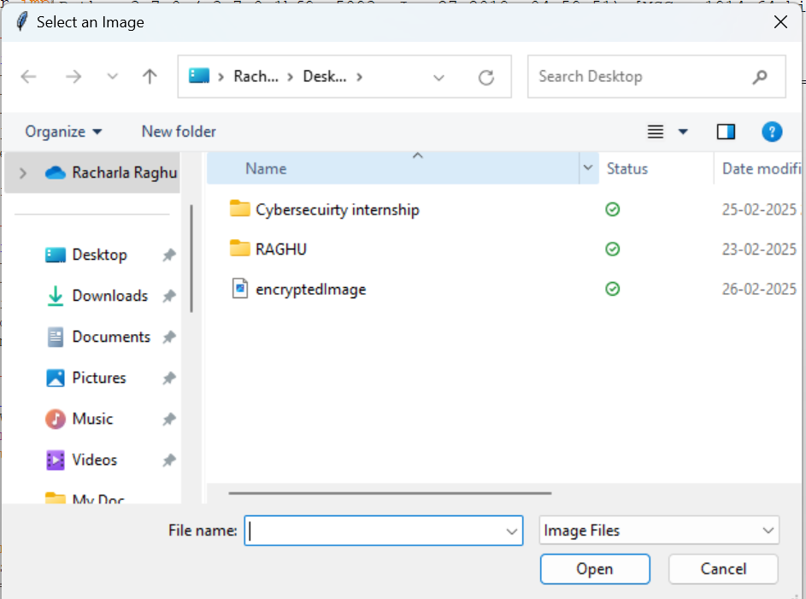
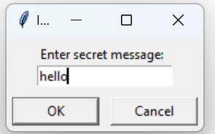
Results
Fig 1 : Select Image
Fig 2 : Enter Secert Message

Slide 8
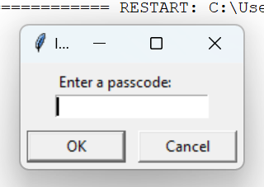

Fig 3 : Enter Passcode
Fig 4 : Decrypted Message

Slide 9
Conclusion
The Secure Data Hiding in Image Using Steganography project successfully implements a method to embed secret messages within image files while ensuring the confidentiality and security of the data. By leveraging the Least Significant Bit (LSB) technique, this system hides the message in a way that is practically undetectable to the naked eye, making it an effective steganographic solution. The addition of password protection ensures that the hidden data is only accessible by authorized users, adding an extra layer of security and confidentiality.

Slide 10
GitHub Link
https://github.com/Raghu070177

Slide 11
THANK YOU

